Slide 1
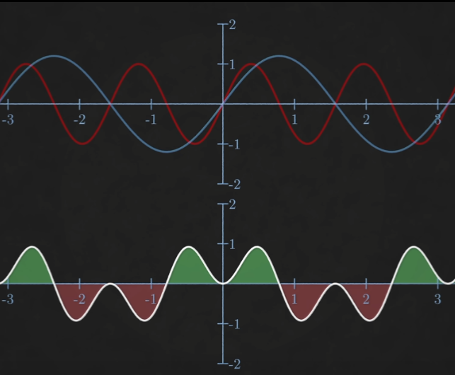
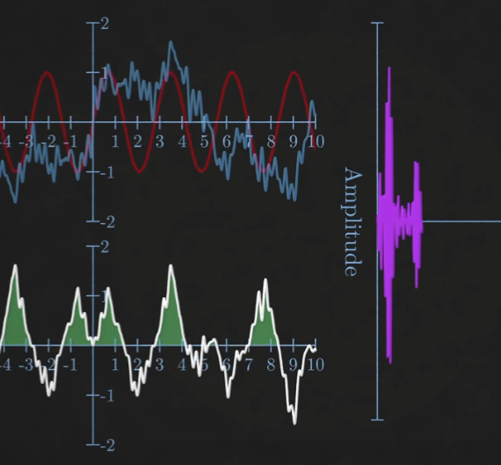
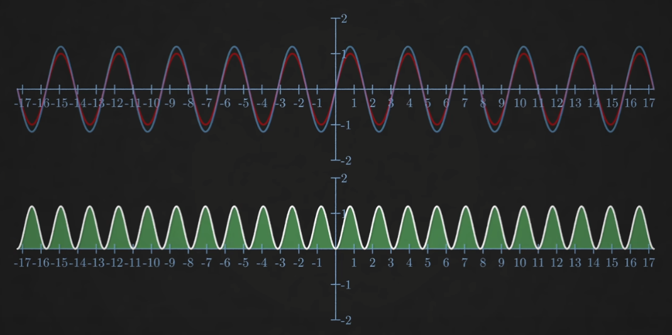
Fourier Analysis in Optical Coherence Tomography
Saban Caliskan
May 2023
Physics and astronmy, NS-267B

Slide 2

Fourier Transform
Linear Transformation
$\hat{f}\left(ξ\right)=\int_{−∞}^{∞}{f\left(x\right)ⅇ^{−ⅈ2πξx}ⅆx}$
$f_{inv}\left(x\right)=\int_{−∞}^{∞}{\hat{f}\left(ξ\right)}ⅇ^{ⅈ2πξx}dξ$
$e^{iθ}=\cos\left(θ\right)+i ∙\sin\left(θ\right)$
Peaks determine Periodicity and Shape
Source: https://en.wikipedia.org/wiki/Fourier_Transform
Source: https://en.wikipedia.org/wiki/Fourier_Series

Slide 3
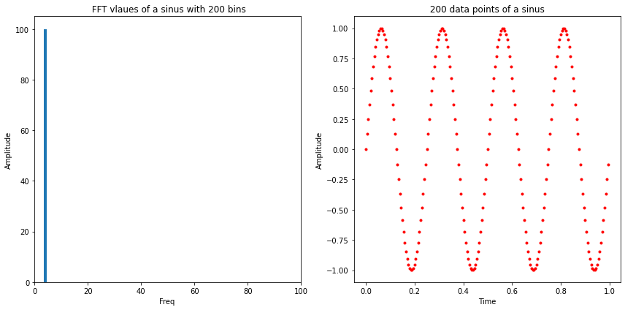
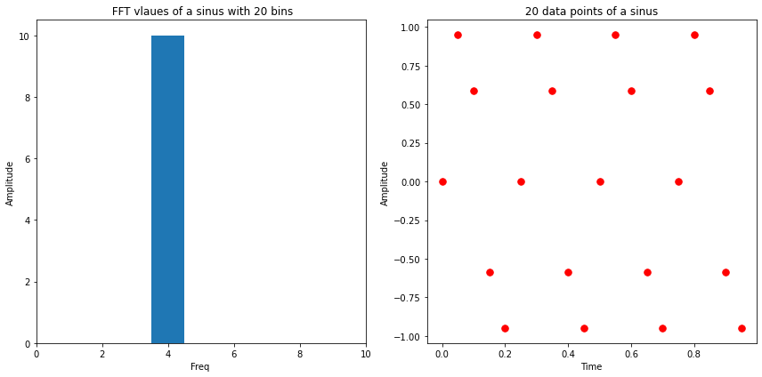
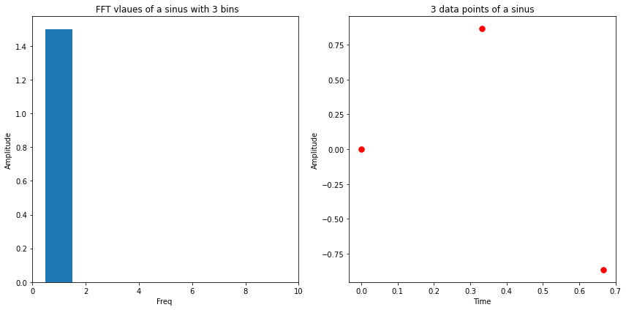

Discrete Fourier Transform
Discrete data
$X_{k}=\sum_{n=0}^{N−1}{x_{n}∙e^{−i\frac{2π}{N}kn}}$
All possible frequencies: $f_{n}=n\frac{1}{2T} , n∈[0, N−1]$
Nyquist Frequency:
‘the Nyquist frequency is the frequency whose cycle-length is twice the interval between samples’, i.e: at least 2 samples
Computation $∝N^2$

Slide 4
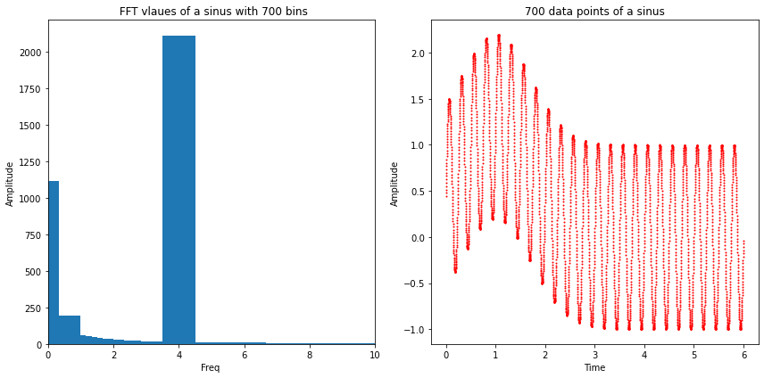
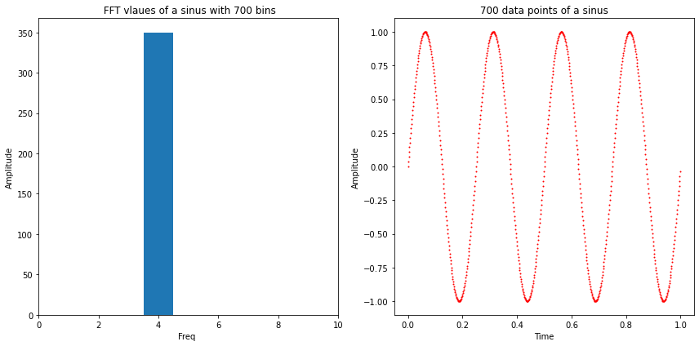
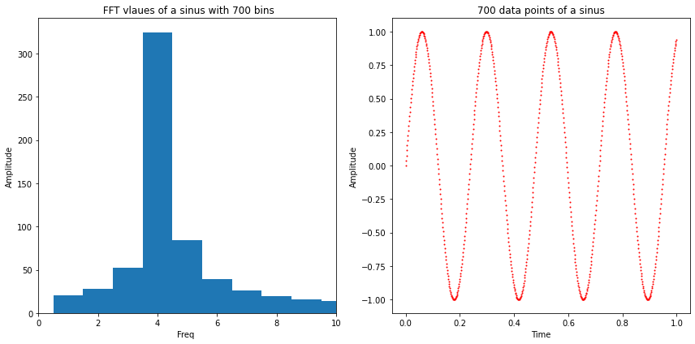
What is our Goal?
Reflected spectrum modulated because of interference
FFT peak corresponds to thickness of sample
Need to find the exact location of the peak in FFT
What if the exact frequency is not exactly in the centre of a bin?

Slide 5
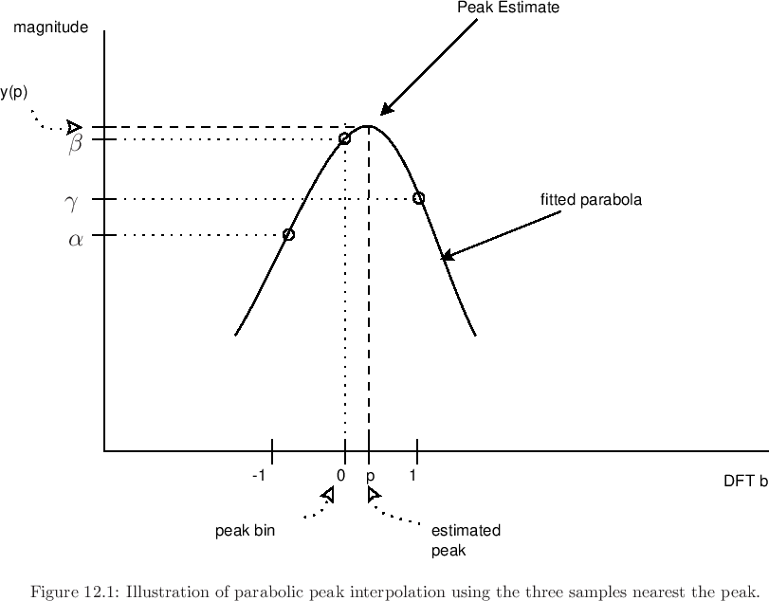
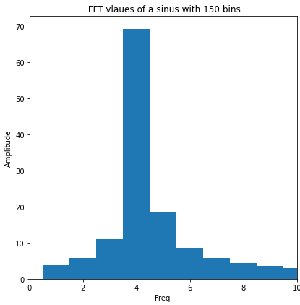

Peak Fitting
2 Methods to interpolate the exact frequency
Quadratic approach:
$y\left(x\right)={−a(x−p)}^{2}+b$ $p= \frac{1}{2}\frac{y\left(−1\right)−y(1)}{y\left(−1\right)−2∙y(o)+y(1)}$
2. Barycentric approach:
Weighted average $p= \frac{∆Y}{Y_{1}{+ Y}_{2}{+Y}_{3}}$ = $\frac{Y_{1} −Y_{3}}{Y_{1}{+ Y}_{2}{+Y}_{3}}$

Slide 6
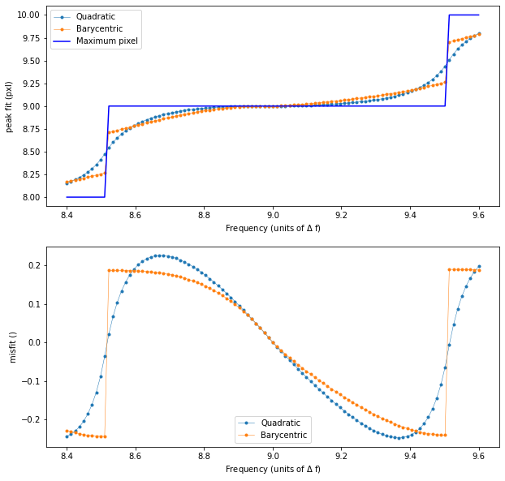
Results
Result for pure sine of 99 different frequencies between 8.4 and 9.6 Δf = 1/350 Hz, N = 700.
1. Quadratic approach:
Continous
Large misfits
2. Barycentric approach:
not continous.
Large misfits

Slide 7
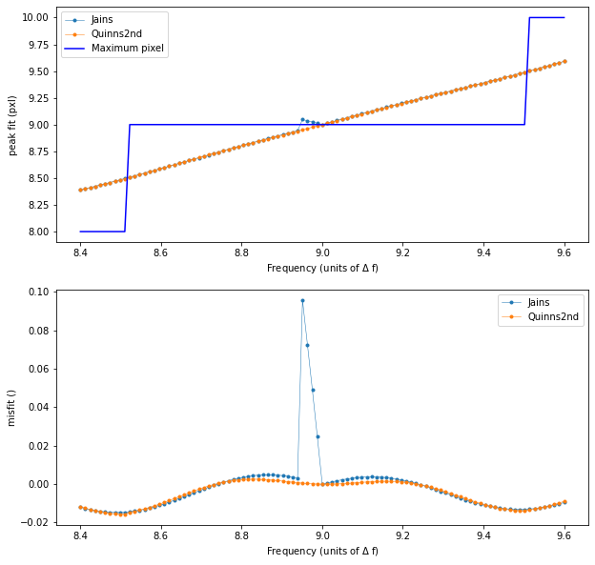
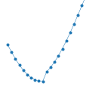
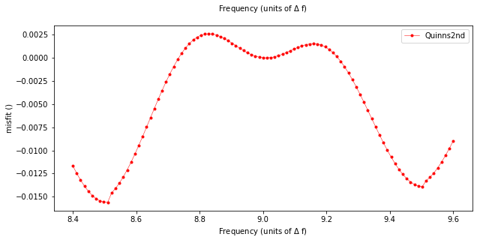
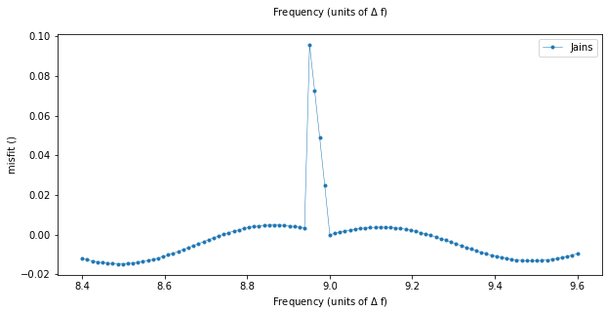
Newer Methods
Jain’s method and Quinn’s 2nd method:
Generally Better
Neither is Continous

Slide 8
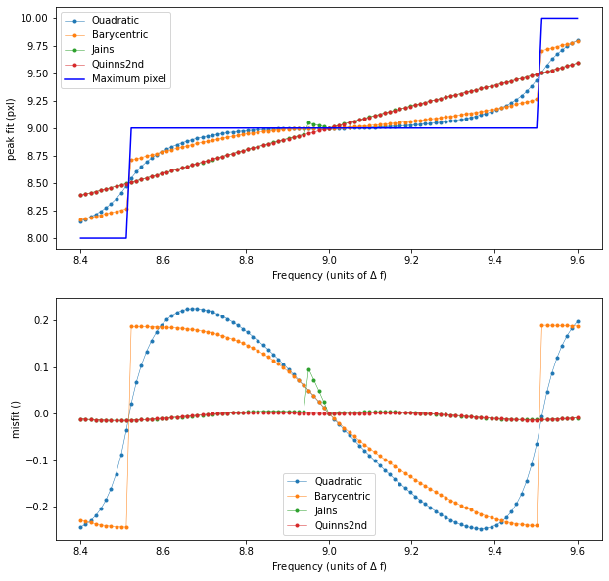
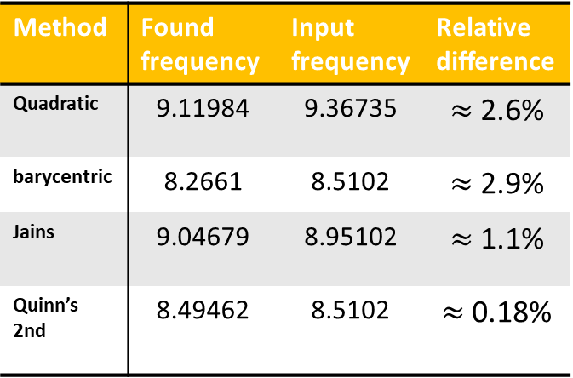
Comparison between methods
Largest found Misfits relative to input data
Method | Found frequency | Input frequency | Relative difference
Quadratic | 9.11984 | 9.36735 | $≈$2.6%
barycentric | 8.2661 | 8.5102 | $≈$2.9%
Jains | 9.04679 | 8.95102 | $≈$1.1%
Quinn’s 2nd | 8.49462 | 8.5102 | $≈$0.18%

Slide 9
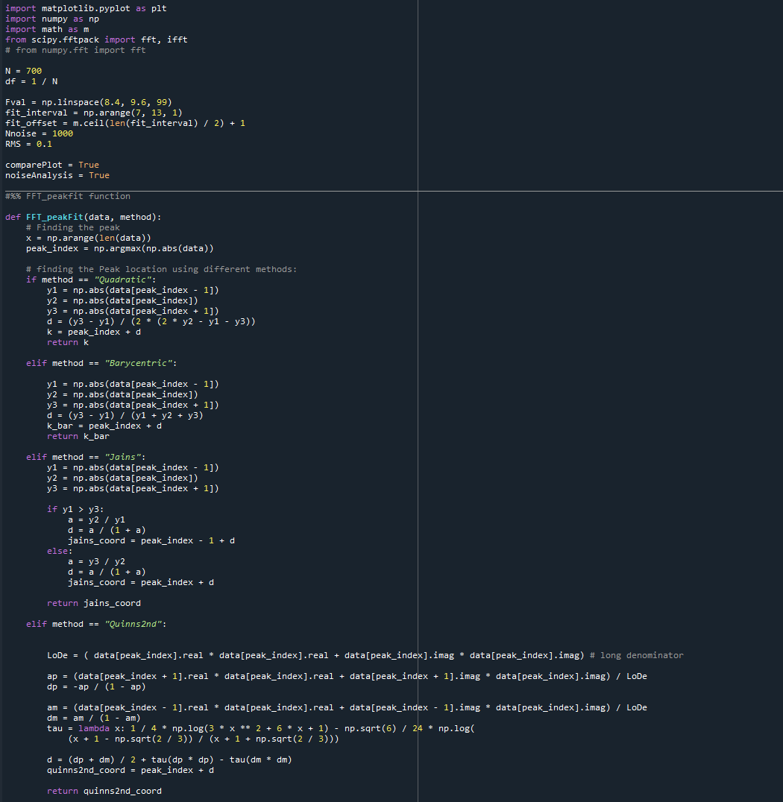
Outlook
Impact of noise on fit
Impact of phase differences on fit
Continuous Quinn’s and Jains

